Slide 1


DIVERSITY SUPPLIER
CHATBOT
ITC 6040 Informatics Capstone Group 1 – Final Presentation
Professor Xiaomu Zhou
Team Members:
Ananya Kakani
Chen Yang
Jhanvi Patel
Sotheavatey Bong
Titiksha Ghosh
Vivek Vaghasiya

Slide 2
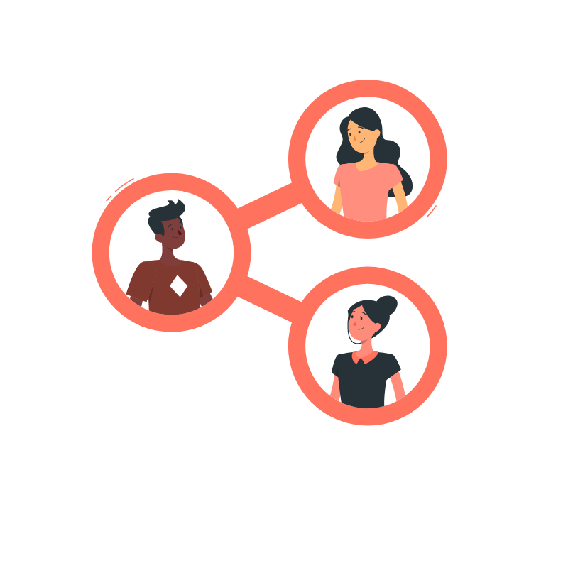
OUR TEAM
Jhanvi
Ananya
Vivek
Team Leader/ Developer
Programmer/ Research
Chen
Research/Data Analyst
Developer/ Research
Tey
Titiksha
Project Manager/ Data Analyst
Research/ User Testing

Slide 3
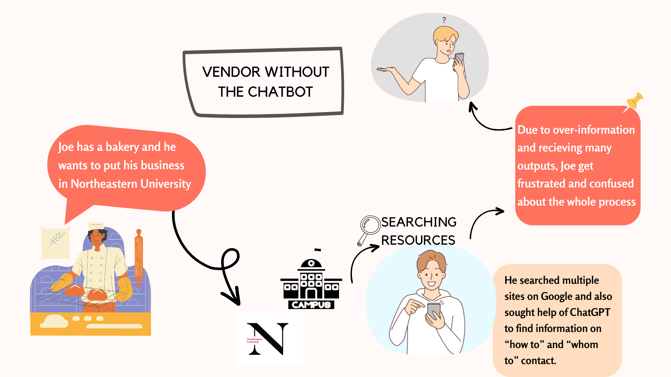
Why Chatbot ?

Slide 4
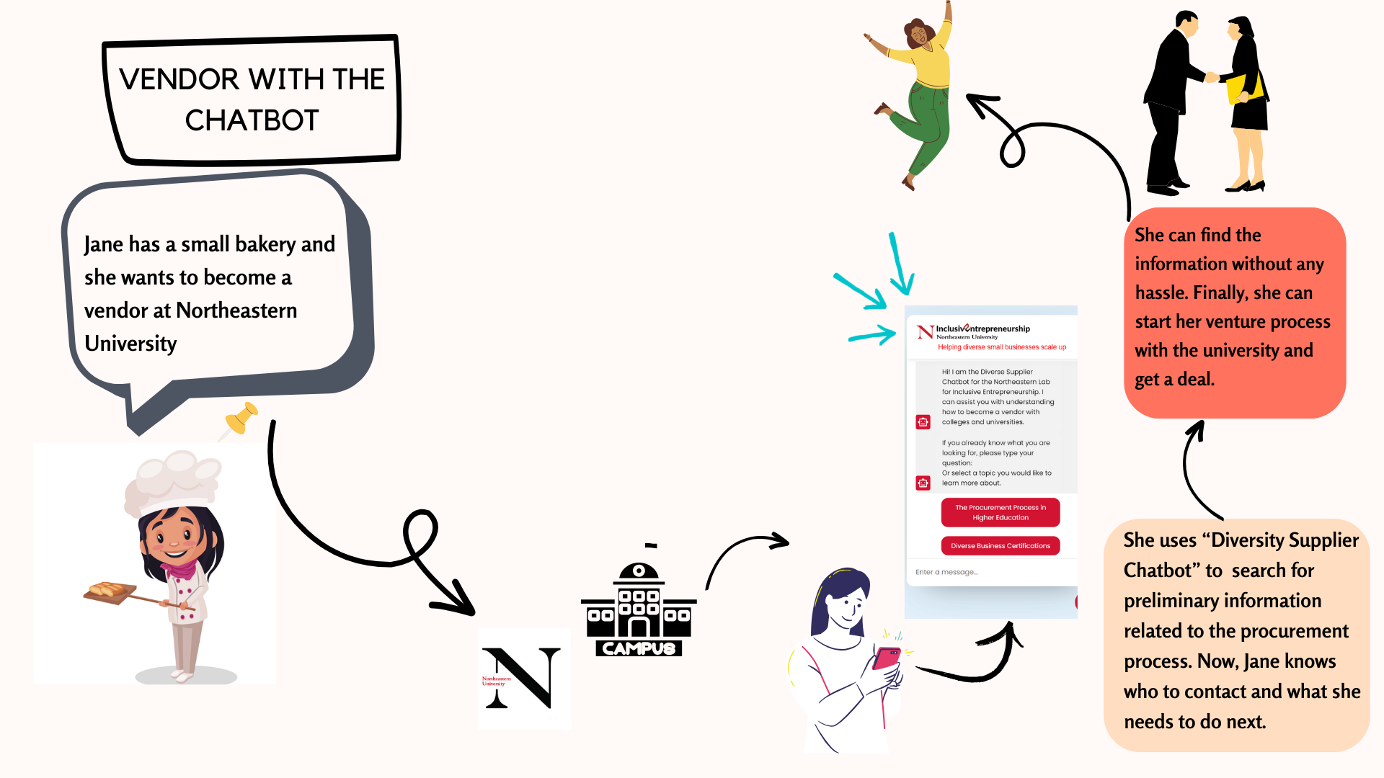
With Chatbot

Slide 5

TABLE OF CONTENTS
01
02
03
ABOUT THE PROJECT
RESEARCH ANALYSIS
DATA COLLECTION
04
05
06
DESIGN PROCESS
FINAL PRODUCT
TAKEAWAY POINTS

Slide 6
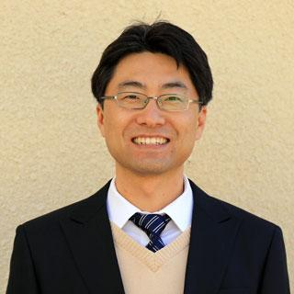
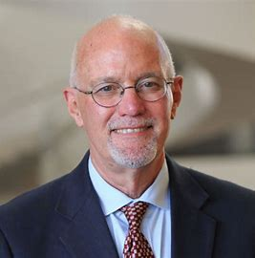
SPONSOR’S BACKGROUND INFORMATION
Dr. Youngbok Ryu
Dr. Carl Zangerl
The project is sponsored by Lab of Inclusive Entrepreneurship (NL4IE) at Northeastern University.
NL4IE endeavors to support economic developments of small businesses with a focus on empowering entrepreneurs facing disadvantages.

Slide 7

ABOUT THE PROJECT
Findings:
Small and diverse businesses lacks awareness of the bidding/contracting opportunities
Unorganized data scattered across various locations
Goal:
Chatbot to drive the small business participation in university market competition

Slide 8

QUALITATIVE RESEARCH ANALYSIS
User Experience Testing
Content Analysis
Data
Collection
Web
Scraping

Slide 9
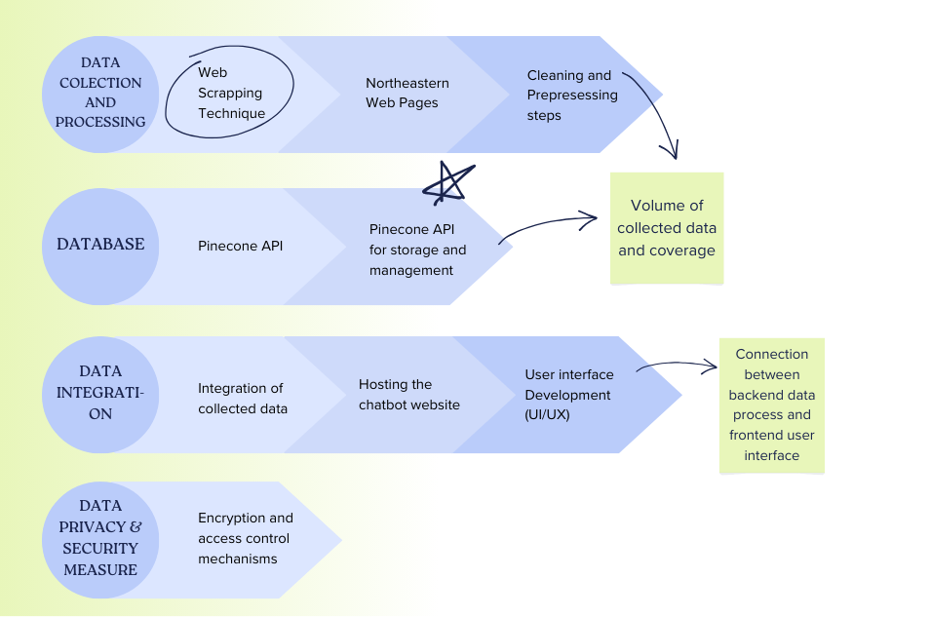
DATA FLOW DIAGRAM FOR THE CHATBOT

Slide 10
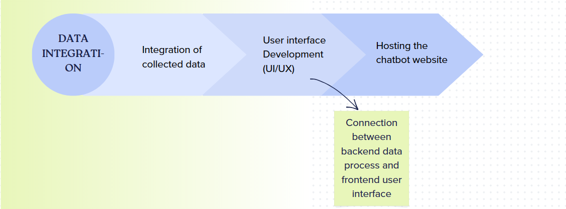
DATA FLOW DIAGRAM FOR THE CHATBOT (CON’T)

Slide 11
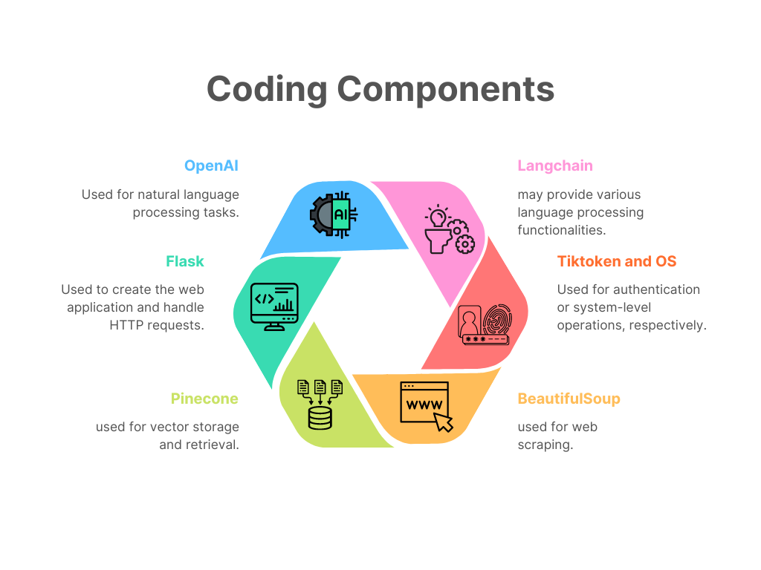
PROGRAMMING COMPONENTS

Slide 12
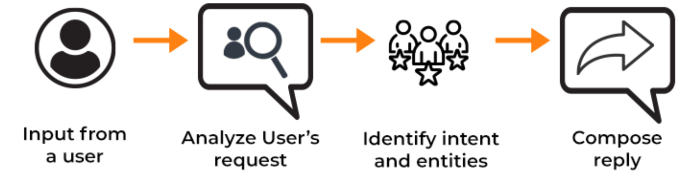
PRODUCT DESIGN AND WORKING

Slide 13
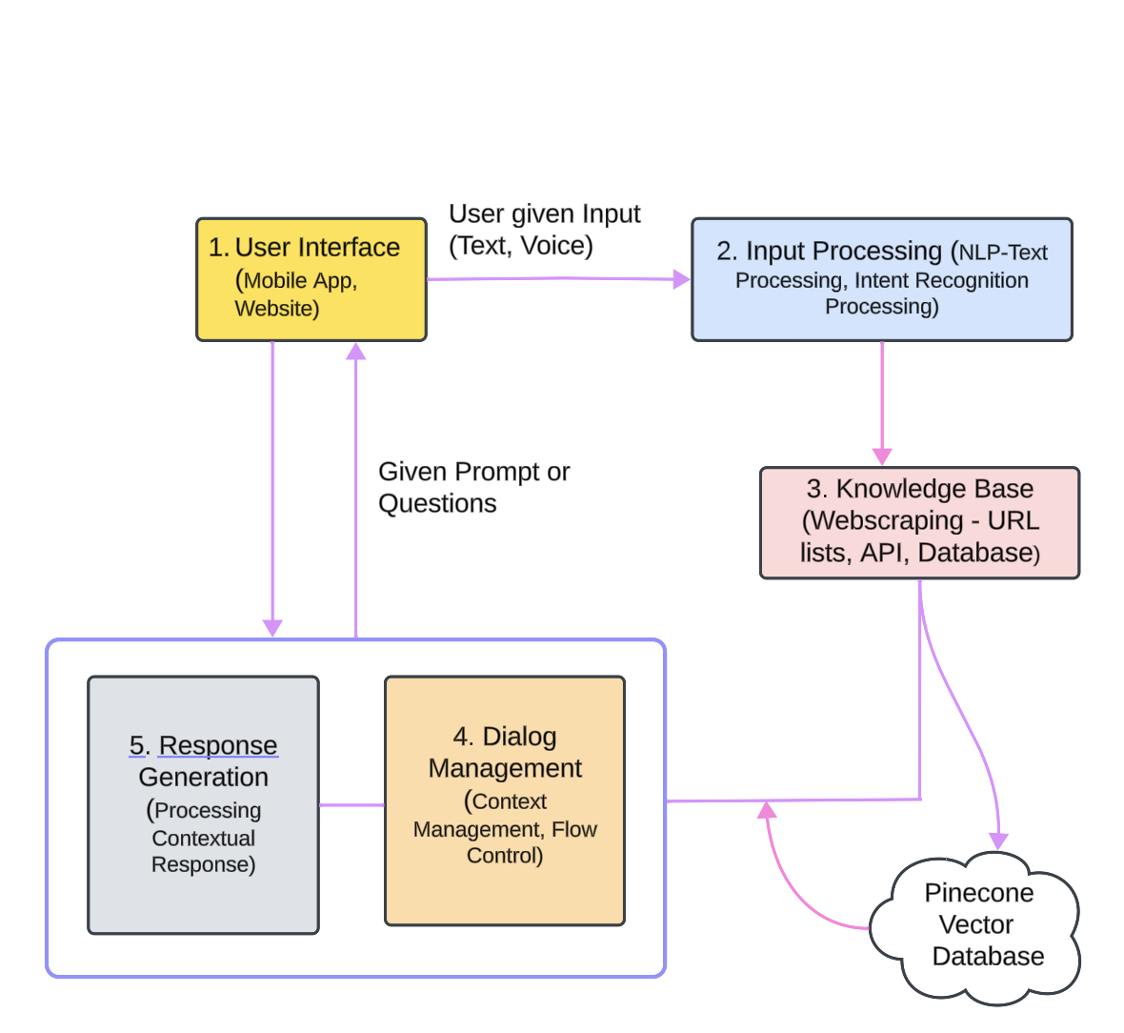
Chatbot Architecture

Slide 14
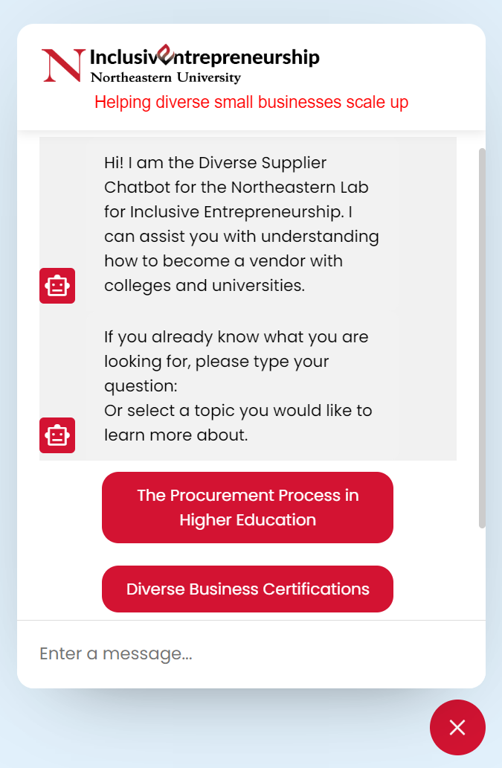
Live DEMO

Slide 15
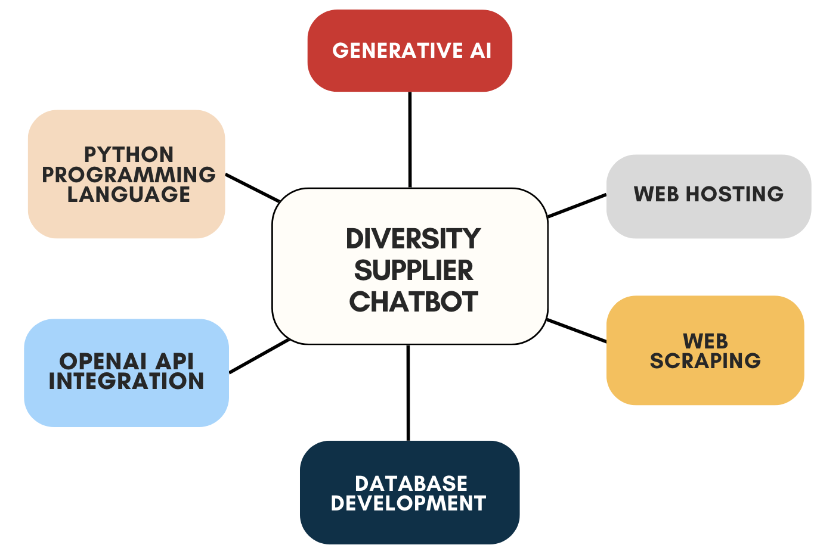
SKILLS ACQUIRED

Slide 16

TAKEAWAY POINTS
Human-Centered Design
Communication with Stakeholders
Project Management
Agile Mindset and Continuous Improvement

Slide 17
FINAL REMARKS
What would We do Differently: Earlier project planning and Maintain Thorough documentation
Next Steps: Refine and Expand the Chatbot capabilities
Acknowledgments: Sponsors, Professor, and Team members
Closing Thoughts

Slide 18

THANK YOU !!!

